Slide 1
SAMPLING DESIGN

Slide 2
The objective of most research projects is to obtain information about the population.
Information about population may be obtained by taking a census or a sample.
A census involves a complete enumeration of the elements of a population. The population parameters can be calculated directly in a straightforward way after the census is enumerated.
A sample, on the other hand, is a subgroup of the population selected for participation in the study.
Sample characteristics, called statistics, are then used to make inferences about the population parameters.

Slide 3
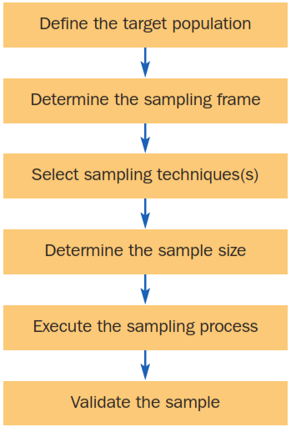
What are the steps of sampling design process?

Slide 4
Determine the target population
Target population
The collection of elements or objects that possess the information sought by the researcher and about which inferences are to be made.
Element
An object that possesses the information sought by the researcher and about which inferences are to be made. In survey research, the element is usually the respondent.
Sampling unit
An element, or a unit containing the element, that is available for selection at some stage of the sampling process.
Extent and time
Extent refers to the geographical boundaries of the research, and the time refers to the period under consideration.

Slide 5
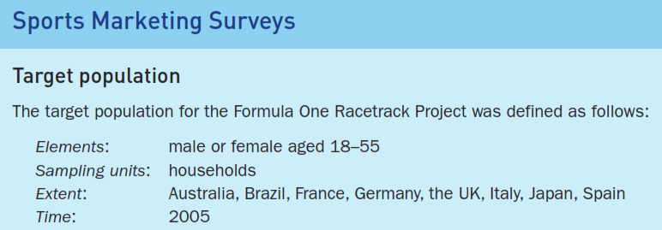

Slide 6
Determine the sampling frame
A sampling frame is a representation of the elements of the target population. It consists of a list for identifying the target population.
Examples of a sampling frame include
Telephone book
Association directory
Listing the firms in an industry
Customer database

Slide 7
Determine the sample size
Sample size refers to the number of elements to be included in the study. Determining the sample size involves several qualitative and quantitative considerations. Important qualitative factors to be considered in determining the sample size include
The importance of the decision,
The nature of the research,
The number of variables,
The nature of the analysis,
Sample sizes used in similar studies,
Incidence rates,
Completion rates, and
Resource constraints.

Slide 8
Convenience sampling
Convenience sampling refers to sampling by obtaining people or units that are conveniently available. The selection of sampling units is left primarily to the interviewer.
Examples of convenience sampling include:
Use of students, church groups and members of social organisations,
Mall intercepts/street interviews without qualifying the respondents,
Tear-out questionnaires included in a newspaper or magazine, and
Journalists interviewing ‘people on the street’.
Researchers generally use convenience samples to obtain a large number of completed questionnaires quickly and economically, or when obtaining a sample through other means is impractical.

Slide 9
A Graphical Illustration of Convenience Sampling
A | B | C | D | E
1 | 6 | 11 | 16 | 21
2 | 7 | 12 | 17 | 22
3 | 8 | 13 | 18 | 23
4 | 9 | 14 | 19 | 24
5 | 10 | 15 | 20 | 25
Group D happens to assemble at a convenient time and place. So all the elements in this Group are selected.
The resulting sample consists of elements 16, 17, 18, 19 and 20. Note, no elements are selected from group A, B, C and E.

Slide 10
Judgemental sampling (purposive sampling)
Judgemental sampling is a form of convenience sampling in which the population elements are selected based on the judgement of the researcher.
Common examples of judgemental sampling include:
Test markets selected to determine the potential of a new product,
Purchase engineers selected in industrial marketing research because they are considered to be representative of the company,
Product testing with individuals who may be particularly fussy or who hold extremely high expectations,

Slide 11
Graphical Illustration of Judgmental Sampling
A | B | C | D | E
1 | 6 | 11 | 16 | 21
2 | 7 | 12 | 17 | 22
3 | 8 | 13 | 18 | 23
4 | 9 | 14 | 19 | 24
5 | 10 | 15 | 20 | 25
The researcher considers groups B, C and E to be typical and convenient. Within each of these groups one or two elements are selected based on typicality and convenience.
The resulting sample consists of elements 8, 10, 11, 13, and 24. Note, no elements are selected
from groups A and D.

Slide 12
Quota sampling
Quota sampling may be viewed as two-stage restricted judgemental sampling.
The first stage consists of developing quotas, of population elements such as age or gender. To develop these quotas, the researcher lists relevant characteristics and determines the distribution of these characteristics in the target population, such as Males 49%, Females 51% (resulting in 490 men and 510 women being selected in a sample of 1,000 respondents).
The quotas ensure that the composition of the sample is the same as the composition of the population with respect to the characteristics of interest.
In the second stage, sample elements are selected based on convenience or judgement.

Slide 13
A Graphical Illustration of Quota Sampling
A | B | C | D | E
1 | 6 | 11 | 16 | 21
2 | 7 | 12 | 17 | 22
3 | 8 | 13 | 18 | 23
4 | 9 | 14 | 19 | 24
5 | 10 | 15 | 20 | 25
A quota of one element from each group, A to E, is imposed. Within each group, one element is selected based on judgment or convenience.
The resulting sample consists of elements 3, 6, 13, 20 and 22. Note, one element is selected from each column or group.

Slide 14
Snowball sampling
A sampling technique in which an initial group of respondents is selected randomly. Subsequent respondents are selected based on the referrals or information provided by the initial respondents.
The main objective of snowball sampling is to estimate characteristics that are rare in the wider population.

Slide 15
A Graphical Illustration of Snowball Sampling
Random Selection Referrals
A | B | C | D | E
1 | 6 | 11 | 16 | 21
2 | 7 | 12 | 17 | 22
3 | 8 | 13 | 18 | 23
4 | 9 | 14 | 19 | 24
5 | 10 | 15 | 20 | 25
Elements 2 and 9 are selected randomly from groups A and B.
Element 2 refers elements 12 and 13. Element 9 refers
element 18.
The resulting sample consists of elements 2, 9, 12, 13, and 18. Note, there are no elements from group E.

Slide 16
Simple random sampling
A sampling technique in which each element has a known and equal probability of selection. Every element is selected independently of every other element, and the sample is drawn by a random procedure from a sampling frame.
This method is equivalent to a lottery system in which names are placed in a container, the container is shaken and the names of the winners are then drawn out in an unbiased manner.

Slide 17
A Graphical Illustration of Simple Random Sampling
A | B | C | D | E
1 | 6 | 11 | 16 | 21
2 | 7 | 12 | 17 | 22
3 | 8 | 13 | 18 | 23
4 | 9 | 14 | 19 | 24
5 | 10 | 15 | 20 | 25
Select five random numbers from 1 to 25.
The resulting sample consists of population elements 3, 7, 9, 16, and 24. Note, there is no element from Group C.

Slide 18
Systematic sampling
In systematic sampling, the sample is chosen by selecting a random starting point and then picking every ith element in succession from the sampling frame. The sampling interval, i, is determined by dividing the population size N by the sample size n and rounding to the nearest whole number.
For example, there are 100,000 elements in the population and a sample of 1,000 is desired. In this case, the sampling interval, i, is 100. A random number between 1 and 100 is selected. If, for example, this number is 23, the sample consists of elements 23, 123, 223, 323, 423, 523, and so on.

Slide 19
A Graphical Illustration of Systematic Sampling
A | B | C | D | E
1 | 6 | 11 | 16 | 21
2 | 7 | 12 | 17 | 22
3 | 8 | 13 | 18 | 23
4 | 9 | 14 | 19 | 24
5 | 10 | 15 | 20 | 25
Select a random number between 1 and 5, say 2.
The resulting sample consists of population 2,
(2+5=) 7, (2+5x2=) 12, (2+5x3=)17, and (2+5x4=) 22. Note, all the elements are selected from a single row.

Slide 20
Stratified sampling
A sampling technique that uses a two step process to partition the population into subsequent subpopulations, or strata. Elements are selected from each stratum by a random procedure.

Slide 21
A Graphical Illustration of Stratified Sampling
A | B | C | D | E
1 | 6 | 11 | 16 | 21
2 | 7 | 12 | 17 | 22
3 | 8 | 13 | 18 | 23
4 | 9 | 14 | 19 | 24
5 | 10 | 15 | 20 | 25
Randomly select a number from 1 to 5
for each stratum, A to E.
The resulting
sample consists of population elements
4, 7, 13, 19 and 21. Note, one element
is selected from each column.

Slide 22
Cluster sampling
A two-step sampling technique where the target population is first divided into subpopulations called clusters, and then a random sample of clusters is selected based on a probability sampling technique such as SRS.
For each selected cluster, either all the elements are included in the sample, or a sample of elements is drawn probabilistically.
The subpopulations or clusters are assumed to contain the diversity of respondents held in the target population.
If all the elements in each selected cluster are included in the sample, the procedure is called one-stage cluster sampling.
If a sample of elements is drawn probabilistically from each selected cluster, the procedure is two-stage cluster sampling.

Slide 23
A Graphical Illustration of Cluster Sampling (2-Stage)
A | B | C | D | E
1 | 6 | 11 | 16 | 21
2 | 7 | 12 | 17 | 22
3 | 8 | 13 | 18 | 23
4 | 9 | 14 | 19 | 24
5 | 10 | 15 | 20 | 25
Randomly select 3 clusters, B, D and E.
Within each cluster, randomly select one
or two elements. The resulting sample
consists of population elements 7, 18, 20, 21, and 23. Note, no elements are selected from clusters A and C.

Slide 24
In a cluster sample, the primary sampling unit is no longer the individual element in the population (for example, grocery stores) but a larger cluster of elements located in proximity to one another (for example, cities).
The area sample is the most popular type of cluster sample. A grocery store researcher, for example, may randomly choose several geographic areas as primary sampling units and then interview all or a sample of grocery stores within the geographic clusters. Interviews are confined to these clusters only. No interviews occur in other clusters. Cluster sampling is classified as a probability sampling technique because of either the random selection of clusters or the random selection of elements within each cluster.

Slide 25
Ideally a cluster should be as heterogeneous as the population itself—a mirror image of the population. A problem may arise with cluster sampling if the characteristics and attitudes of the elements within the cluster are too similar. For example, geographic neighborhoods tend to have residents of the same socioeconomic status.
Students at a university tend to share similar beliefs. This problem may be mitigated by constructing clusters composed of diverse elements and by selecting a large number of sampled clusters.

Slide 26
Sampling Techniques
Nonprobability
Sampling Techniques
Probability
Sampling Techniques
Convenience
Sampling
Judgmental
Sampling
Quota
Sampling
Snowball
Sampling
Simple Random
Sampling
Systematic
Sampling
Stratified
Sampling
Cluster
Sampling
A CLASSIFICATION OF SAMPLING TECHNIQUES
Important

Slide 27
Probability and Nonprobability sampling
In probability sampling, every element in the population has a known, nonzero probability of selection.
In nonprobability sampling, the probability of any particular member of the population being chosen is unknown. The selection of sampling units in nonprobability sampling is quite arbitrary, as researchers rely heavily on personal judgment.
Technically, no appropriate statistical techniques exist for measuring random sampling error from a nonprobability sample.
Therefore, projecting the data beyond the sample is, technically speaking, statistically inappropriate.

Slide 28
Strengths and Weaknesses of Basic Sampling Techniques
Technique
Strengths
Weaknesses
Nonprobability Sampling
Least expensive, least
Selection bias, sample not
Convenience sampling
time-consuming, most
representative, not recommended for
convenient
descriptive or causal research
Judgmental sampling
Low cost, convenient,
Does not allow generalization,
not time-consuming
subjective
Quota sampling
Sample can be controlled
Selection bias, no assurance of
for certain characteristics
representativeness
Snowball sampling
Can estimate rare
Time-consuming
characteristics
Probability sampling
Easily understood,
Difficult to construct sampling
Simple random sampling
results
projectable
frame, expensive,
lower precision,
(SRS)
no assurance of
representativeness
Systematic sampling
Can increase
Can decrease
representativeness
representativeness,
easier to implement than
SRS, sampling frame not
necessary
Stratified sampling
Include all important
Difficult to select relevant
subpopulations,
stratification variables, not feasible to
precision
stratify on many variables, expensive
Cluster sampling
Easy to implement, cost
Imprecise, difficult to compute and
effective
interpret results

Slide 29
THANK YOU

